Slide 1
BITS Pilani
Dr. Raja Muthalagu
Department of Computer Science

Slide 2
ES ZC481 / IS ZC467, COMPUTER NETWORKS
Lecture No. 5

Slide 3
LECT5. ARP, Switches, Ethernet frame, VLAN

Slide 4
MAC addresses and ARP
32-bit IP address:
network-layer address for interface
used for layer 3 (network layer) forwarding
MAC (or LAN or physical or Ethernet) address:
function: used ‘locally” to get frame from one interface to another physically-connected interface (same network, in IP-addressing sense)
48 bit MAC address (for most LANs) burned in NIC ROM, also sometimes software settable
e.g.: 1A-2F-BB-76-09-AD
hexadecimal (base 16) notation
(each “number” represents 4 bits)

Slide 5

LAN addresses and ARP
Each adapter on LAN has unique LAN address
1A-2F-BB-76-09-AD
LAN
(wired or
wireless)
adapter
71-65-F7-2B-08-53
58-23-D7-FA-20-B0
0C-C4-11-6F-E3-98

Slide 6
LAN addresses (more)
MAC address allocation administered by IEEE
manufacturer buys portion of MAC address space (to assure uniqueness)
analogy:
MAC address: like Social Security Number
IP address: like postal address
MAC flat address ➜ portability
can move LAN card from one LAN to another
IP hierarchical address not portable
address depends on IP subnet to which node is attached

Slide 7


ARP: address resolution protocol
ARP table: each IP node (host, router) on LAN has table
IP/MAC address mappings for some LAN nodes:
< IP address; MAC address; TTL>
TTL (Time To Live): time after which address mapping will be forgotten (typically 20 min)
137.196.7.78
Question: how to determine
interface’s MAC address, knowing its IP address?
1A-2F-BB-76-09-AD
137.196.7.23
137.196.7.14
LAN
71-65-F7-2B-08-53
58-23-D7-FA-20-B0
0C-C4-11-6F-E3-98
137.196.7.88

Slide 8
ARP protocol: same LAN
A wants to send datagram to B
B’s MAC address not in A’s ARP table.
A broadcasts ARP query packet, containing B's IP address
dest MAC address = FF-FF-FF-FF-FF-FF
all nodes on LAN receive ARP query
B receives ARP packet, replies to A with its (B's) MAC address
frame sent to A’s MAC address (unicast)
A caches (saves) IP-to-MAC address pair in its ARP table until information becomes old (times out)
soft state: information that times out (goes away) unless refreshed
ARP is “plug-and-play”:
nodes create their ARP tables without intervention from net administrator

Slide 9
ARP Request and Reply
broadcast

Slide 10
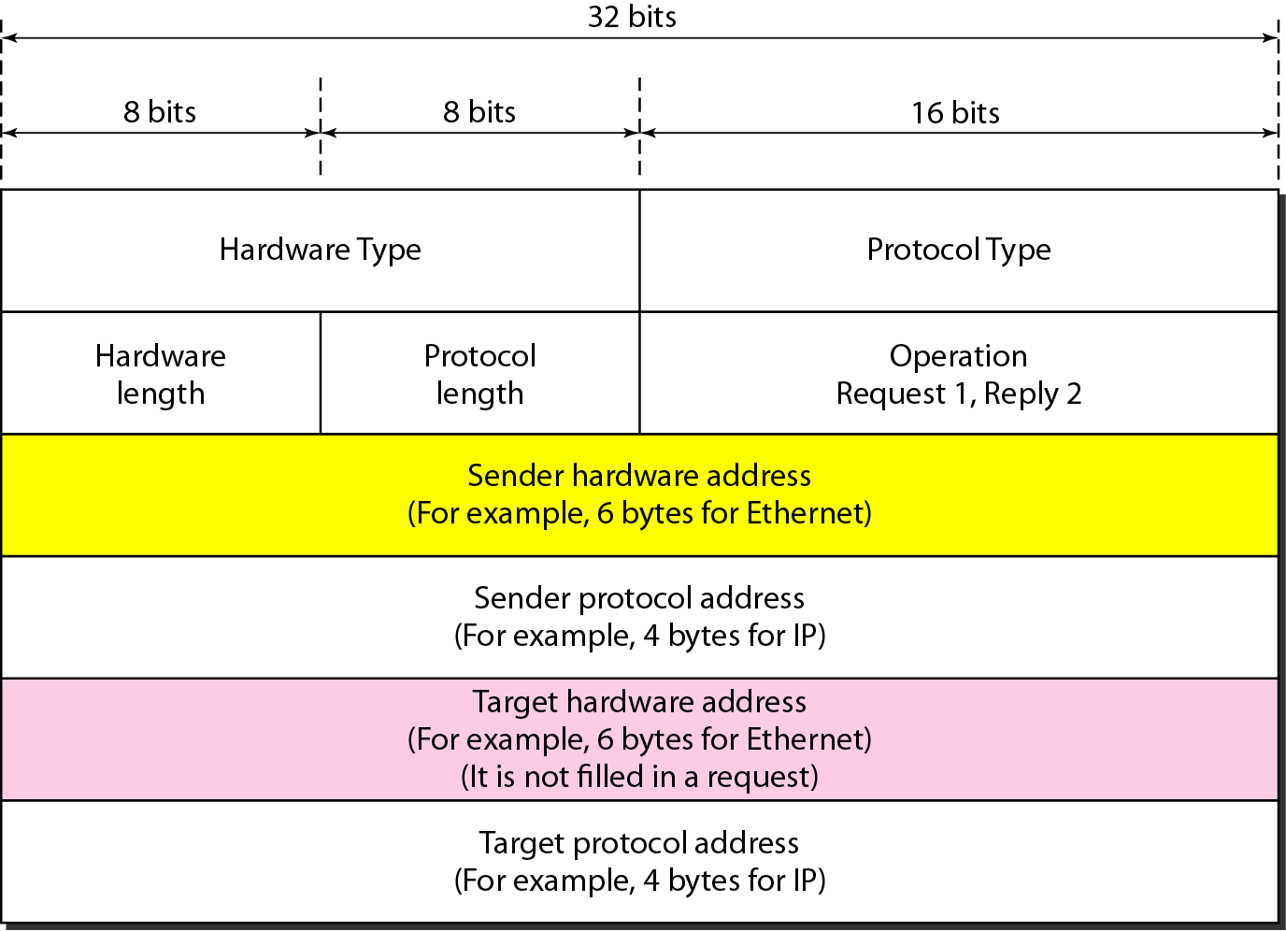
ARP packet
Type of network on which ARP is running. For ethernet it is 1.
Length of logical address in bytes.
For IPv4: (0800)₁₆
Length of physical address. For ethernet it is 6 byte.
Type of ARP packet

Slide 11
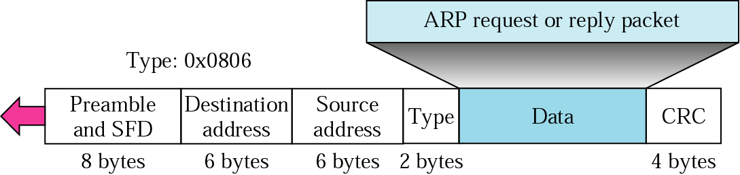
Encapsulation of ARP packet
For example, an EtherType value of 0x0800 signals that the frame contains an IPv4datagram. Likewise, an EtherType of 0x0806 indicates an ARP frame, 0x8100 indicates an IEEE 802.1Q frame and 0x86DD indicates an IPv6 frame
Preamble: Useful for synchronizing clocks and also SFD: signal the beginning of frame

Slide 12
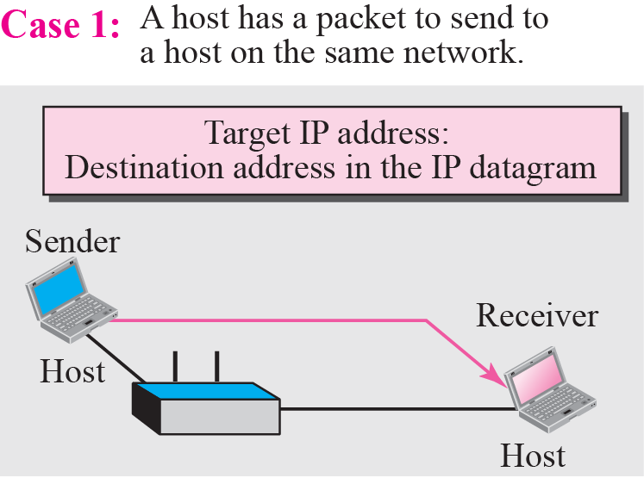
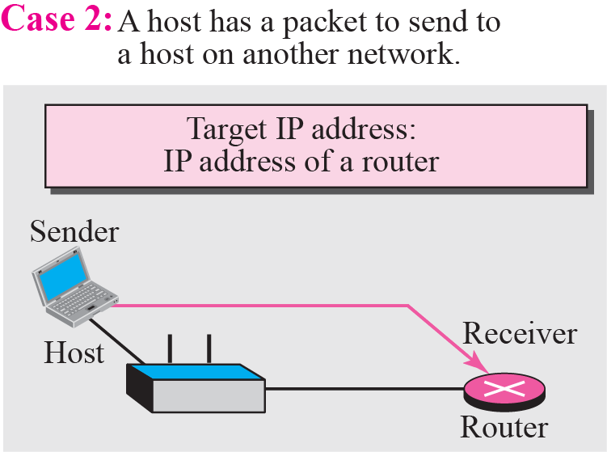
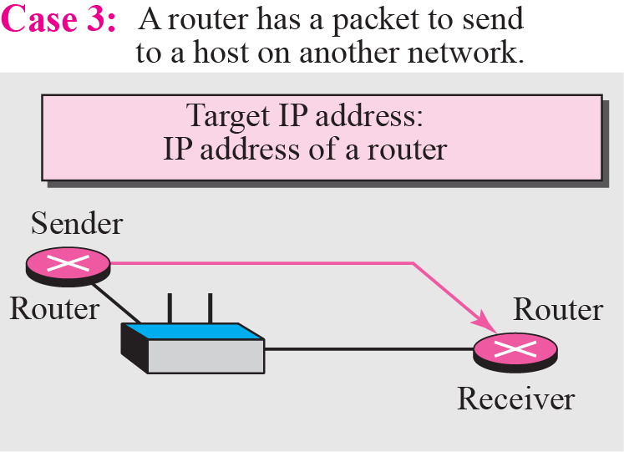
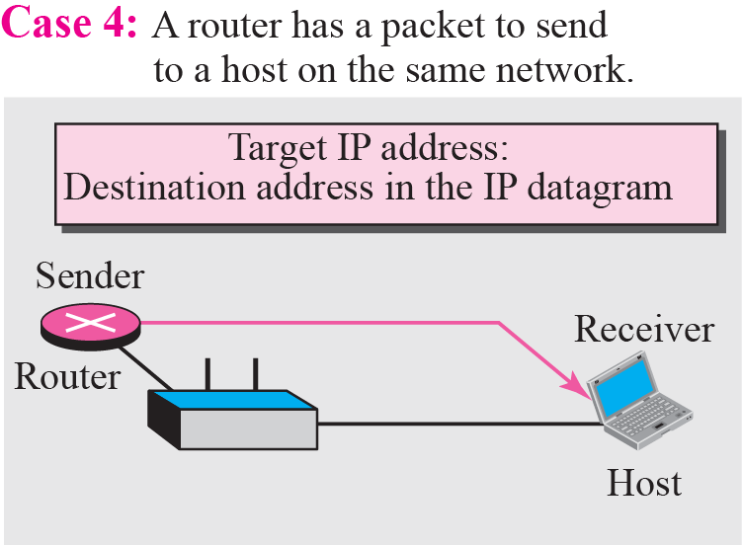
Four cases using ARP

Slide 13
Addressing: routing to another LAN
walkthrough: send datagram from A to B via R
focus on addressing – at IP (datagram) and MAC layer (frame)
assume A knows B’s IP address
assume A knows IP address of first hop router, R (how?)
assume A knows R’s MAC address (how?)
A
B
R
111.111.111.111
222.222.222.222
74-29-9C-E8-FF-55
49-BD-D2-C7-56-2A
222.222.222.220
1A-23-F9-CD-06-9B
111.111.111.112
111.111.111.110
222.222.222.221
CC-49-DE-D0-AB-7D
E6-E9-00-17-BB-4B
88-B2-2F-54-1A-0F

Slide 14
Addressing: routing to another LAN
A creates IP datagram with IP source A, destination B
A creates link-layer frame with R's MAC address as dest, frame contains A-to-B IP datagram
MAC src: 74-29-9C-E8-FF-55
MAC dest: E6-E9-00-17-BB-4B
IP
Eth
Phy
IP src: 111.111.111.111
IP dest: 222.222.222.222
A
B
R
111.111.111.111
222.222.222.222
74-29-9C-E8-FF-55
49-BD-D2-C7-56-2A
222.222.222.220
1A-23-F9-CD-06-9B
111.111.111.112
111.111.111.110
222.222.222.221
CC-49-DE-D0-AB-7D
E6-E9-00-17-BB-4B
88-B2-2F-54-1A-0F

Slide 15
Addressing: routing to another LAN
frame sent from A to R
frame received at R, datagram removed, passed up to IP
MAC src: 74-29-9C-E8-FF-55
MAC dest: E6-E9-00-17-BB-4B
IP src: 111.111.111.111
IP dest: 222.222.222.222
IP
Eth
Phy
IP src: 111.111.111.111
IP dest: 222.222.222.222
IP
Eth
Phy
A
B
R
111.111.111.111
222.222.222.222
74-29-9C-E8-FF-55
49-BD-D2-C7-56-2A
222.222.222.220
1A-23-F9-CD-06-9B
111.111.111.112
111.111.111.110
222.222.222.221
CC-49-DE-D0-AB-7D
E6-E9-00-17-BB-4B
88-B2-2F-54-1A-0F

Slide 16
Addressing: routing to another LAN
R forwards datagram with IP source A, destination B
R creates link-layer frame with B's MAC address as dest, frame contains A-to-B IP datagram
MAC src: 1A-23-F9-CD-06-9B
MAC dest: 49-BD-D2-C7-56-2A
IP
Eth
Phy
IP
Eth
Phy
IP src: 111.111.111.111
IP dest: 222.222.222.222
A
B
R
111.111.111.111
222.222.222.222
74-29-9C-E8-FF-55
49-BD-D2-C7-56-2A
222.222.222.220
1A-23-F9-CD-06-9B
111.111.111.112
111.111.111.110
222.222.222.221
CC-49-DE-D0-AB-7D
E6-E9-00-17-BB-4B
88-B2-2F-54-1A-0F

Slide 17
Addressing: routing to another LAN
R forwards datagram with IP source A, destination B
R creates link-layer frame with B's MAC address as dest, frame contains A-to-B IP datagram
MAC src: 1A-23-F9-CD-06-9B
MAC dest: 49-BD-D2-C7-56-2A
IP src: 111.111.111.111
IP dest: 222.222.222.222
IP
Eth
Phy
A
B
R
111.111.111.111
222.222.222.222
74-29-9C-E8-FF-55
49-BD-D2-C7-56-2A
222.222.222.220
1A-23-F9-CD-06-9B
111.111.111.112
111.111.111.110
222.222.222.221
CC-49-DE-D0-AB-7D
E6-E9-00-17-BB-4B
88-B2-2F-54-1A-0F

Slide 18
What is Ethernet?
Ethernet is a widely used local-area network (LAN) protocol.
A system for connecting a number of computer systems to form a local area network, with protocols to control the passing of information and to avoid simultaneous transmission by two or more systems.

Slide 19
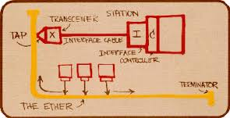
ETHERNET

Slide 20
IEEE Ethernet
In IEEE 802.3 Ethernet Data link layer is split into two sublayers:
Bottom part: MAC
The frame is called IEEE 802.3
Handles framing, MAC addressing, Medium Access control
Specific implementation for each LAN protocol
Defines CSMA/CD as the access method for Ethernet LANs and Token passing method for Token Ring.
Implemented in hardware
Top part: LLC (Logical Link Control)
The subframe is called IEEE 802.2
Provides error and flow control if needed
It makes the MAC sublayer transparent
Allows interconnectivity between different LANs data link layers
Used to multiplex multiple network layer protocols in the data link layer frame
Implemented in software

Slide 21

Ethernet: physical topology
bus: popular through mid 90s
all nodes in same collision domain (can collide with each other)
star: prevails today
active switch in center
each “spoke” runs a (separate) Ethernet protocol (nodes do not collide with each other)
switch
star
bus: coaxial cable

Slide 22
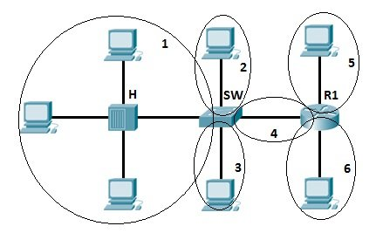
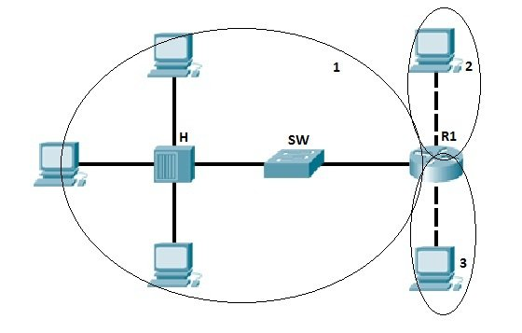
Collision Domain
Broadcast Domain

Slide 23
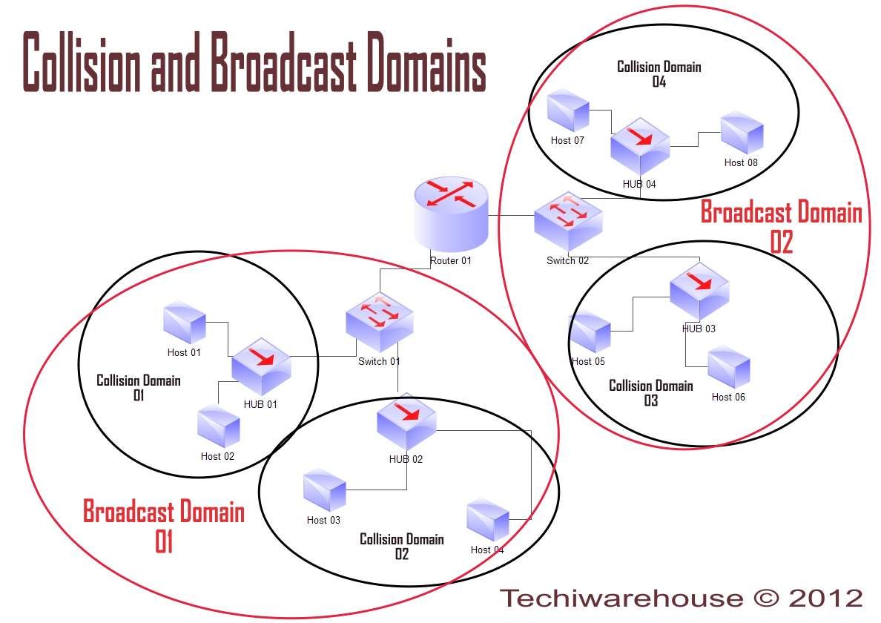

Slide 24
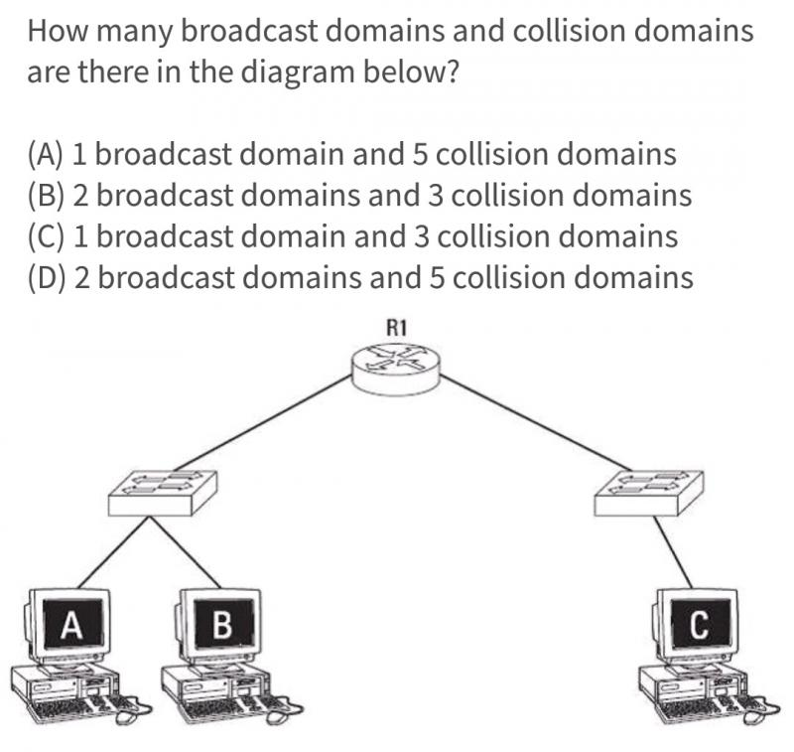

Slide 25
Normal Ethernet Operation
B
C
Address mismatch
packet discarded
Address mismatch
packet discarded
Send data
to node D
Address match
packet processed
Transmitted packet seen
by all stations on the LAN
(broadcast medium)
A
D
Data

Slide 26
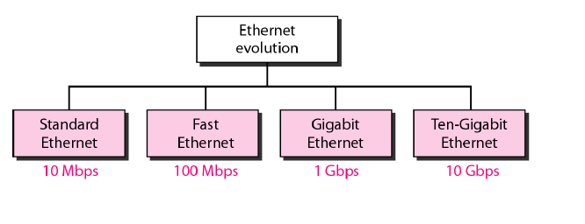
Ethernet evolution through four generations

Slide 27
STANDARD ETHERNET
We refer to the original Ethernet technology with the data rate of 10Mbps as the Standard Ethernet.
Connectionless & Unreliable Services- frames are send independent and no connection establishment and termination
Chance for dropping of frames is high.
CSMA/CD access method

Slide 28
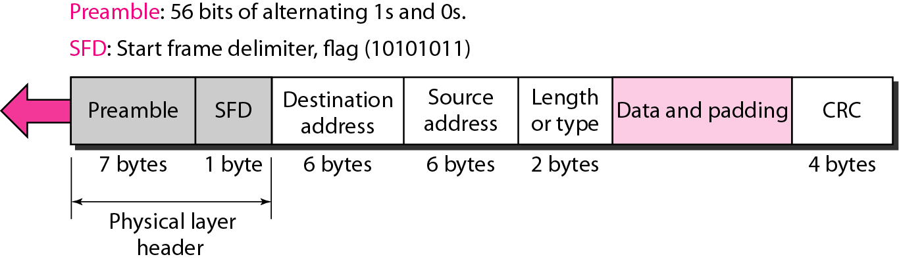
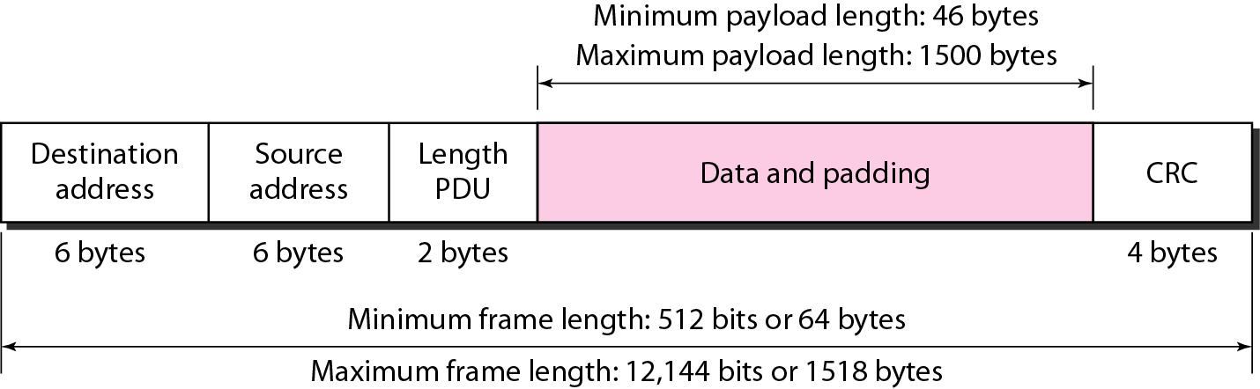
ETHERNET (IEEE 802.3) FRAME

Slide 29
Ethernet frame structure
sending adapter encapsulates IP datagram (or other network layer protocol packet) in Ethernet frame
preamble:
7 bytes with pattern 10101010 followed by one byte with pattern 10101011
used to synchronize receiver, sender clock rates
type
preamble
dest.
address
source
address
data (payload)
CRC

Slide 30
Ethernet frame structure (more)
addresses: 6 byte source, destination MAC addresses
if adapter receives frame with matching destination address, or with broadcast address (e.g. ARP packet), it passes data in frame to network layer protocol
otherwise, adapter discards frame
type: indicates higher layer protocol (mostly IP but others possible, e.g., Novell IPX, AppleTalk)
CRC: cyclic redundancy check at receiver
error detected: frame is dropped
type
preamble
dest.
address
source
address
data (payload)
CRC

Slide 31
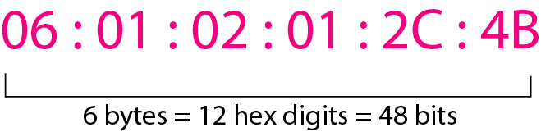
Addressing
Example of an Ethernet address in hexadecimal notation

Slide 32
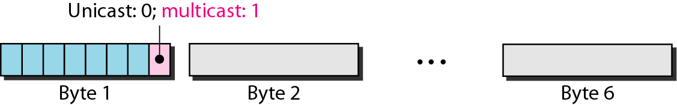
Unicast and Multicast Addresses
The least significant bit of the first byte defines the type of address. If the bit is 0, the address is unicast; otherwise, it is multicast.
The broadcast destination address is a special case of the multicast address in which all bits are 1s.

Slide 33
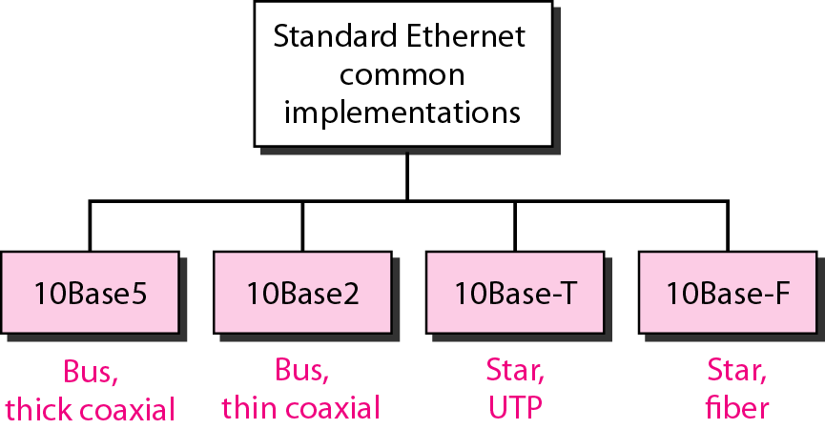
Categories of Standard Ethernet

Slide 34
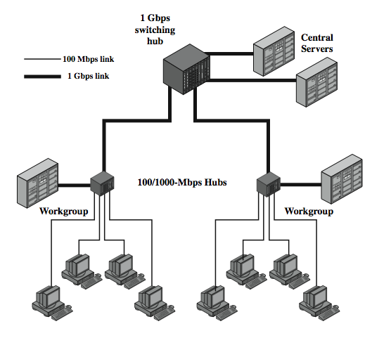
Gigabit Ethernet Configuration
Notes:
In late 1995, the IEEE 802.3 committee formed a High-Speed Study Group to investigate means for conveying packets in Ethernet format at speeds in the gigabits per second range. The strategy for Gigabit Ethernet is the same as that for Fast Ethernet. While defining a new medium and transmission specification, Gigabit Ethernet retains the CSMA/CD protocol and Ethernet format of its 10-Mbps and 100-Mbps predecessors. It is compatible with 100BASE-T and 10BASE-T, preserving a smooth migration path. As more organizations move to 100BASE-T, putting huge traffic loads on backbone networks, demand for Gigabit Ethernet has intensified.
Stallings DCC8e Figure 16.4 shows a typical application of Gigabit Ethernet. A 1-Gbps switching hub provides backbone connectivity for central servers and high-speed workgroup hubs. Each workgroup LAN switch supports both 1-Gbps links, to connect to the backbone LAN switch and to support high-performance workgroup servers, and 100-Mbps links, to support high-performance workstations, servers, and 100-Mbps LAN switches.

Slide 35
Ethernet switch
link-layer device: takes an active role
store, forward Ethernet frames
examine incoming frame’s MAC address, selectively forward frame to one-or-more outgoing links when frame is to be forwarded on segment, uses CSMA/CD to access segment
transparent
hosts are unaware of presence of switches
plug-and-play, self-learning
switches do not need to be configured

Slide 36
Switch: multiple simultaneous transmissions
hosts have dedicated, direct connection to switch
switches buffer packets
Ethernet protocol used on each incoming link, but no collisions; full duplex
each link is its own collision domain
switching: A-to-A’ and B-to-B’ can transmit simultaneously, without collisions
A
C’
B
6
1
2
5
4
3
B’
C
A’
switch with six interfaces
(1,2,3,4,5,6)

Slide 37
Switch forwarding table
Q: how does switch know A’ reachable via interface 4, B’ reachable via interface 5?
A
C’
B
A: each switch has a switch table, each entry:
(MAC address of host, interface to reach host, time stamp)
looks like a routing table!
6
1
2
5
4
3
B’
C
A’
Q: how are entries created, maintained in switch table?
something like a routing protocol?
switch with six interfaces
(1,2,3,4,5,6)

Slide 38
Switch: self-learning
Source: A
Dest: A’
switch learns which hosts can be reached through which interfaces
when frame received, switch “learns” location of sender: incoming LAN segment
records sender/location pair in switch table
A
A A’
C’
B
6
1
2
5
4
3
B’
C
A’
MAC addr interface TTL
A
1
60
Switch table
(initially empty)

Slide 39
Switch: frame filtering/forwarding
when frame received at switch:
1. record incoming link, MAC address of sending host
2. index switch table using MAC destination address
3. if entry found for destination then {
if destination on segment from which frame arrived then drop frame
else forward frame on interface indicated by entry
}
else flood /* forward on all interfaces except arriving
interface */

Slide 40
Self-learning, forwarding: example
Source: A
Dest: A’
A
A A’
frame destination, A’, locaton unknown:
flood
C’
B
destination A location known:
6
1
2
A A’
A A’
A A’
A A’
selectively send
on just one link
A A’
5
4
3
B’
C
A’ A
A’
MAC addr interface TTL
A
1
60
switch table
(initially empty)
A’
4
60

Slide 41

Interconnecting switches
switches can be connected together
S₄
S₁
S₃
A
S₂
F
I
B
C
D
E
G
H
Q: sending from A to G - how does S₁ know to forward frame destined to F via S₄ and S₃?
A: self learning! (works exactly the same as in single-switch case!)

Slide 42
Self-learning multi-switch example
Suppose C sends frame to I, I responds to C
S₄
S₁
S₃
A
S₂
F
I
B
C
D
E
G
H
Q: show switch tables and packet forwarding in S₁, S₂, S₃, S₄

Slide 43
Switches vs. routers
application
transport
network
link
physical
both are store-and-forward:
routers: network-layer devices (examine network-layer headers)
switches: link-layer devices (examine link-layer headers)
both have forwarding tables:
routers: compute tables using routing algorithms, IP addresses
switches: learn forwarding table using flooding, learning, MAC addresses
datagram
frame
link
physical
frame
switch
network
link
physical
datagram
frame
application
transport
network
link
physical

Slide 44


VLANs: motivation
Disadvantages of Switched LAN:
Lack of traffic isolation
Inefficient use of switches
Managing users
consider:
CS user moves office to EE, but wants connect to CS switch?
single broadcast domain:
all layer-2 broadcast traffic (ARP, DHCP, unknown location of destination MAC address) must cross entire LAN
security/privacy, efficiency issues
Computer
Science
Computer
Engineering
Electrical
Engineering

Slide 45
VLANs
port-based VLAN: switch ports grouped (by switch management software) so that single physical switch ……
Virtual Local
Area Network
1
7
9
15
2
8
10
16
switch(es) supporting VLAN capabilities can be configured to define multiple virtual LANS over single physical LAN infrastructure.
…
…
Electrical Engineering
(VLAN ports 1-8)
Computer Science
(VLAN ports 9-15)
… operates as multiple virtual switches
1
7
9
15
2
8
10
16
…
…
Electrical Engineering
(VLAN ports 1-8)
Computer Science
(VLAN ports 9-16)

Slide 46

Port-based VLAN
router
traffic isolation: frames to/from ports 1-8 can only reach ports 1-8
can also define VLAN based on MAC addresses of endpoints, rather than switch port
1
7
9
15
2
8
10
16
dynamic membership: ports can be dynamically assigned among VLANs
…
…
Electrical Engineering
(VLAN ports 1-8)
Computer Science
(VLAN ports 9-15)
forwarding between VLANS: done via routing (just as with separate switches)
in practice vendors sell combined switches plus routers

Slide 47
VLANS spanning multiple switches
1
7
9
15
1
3
5
7
2
8
10
16
2
4
6
8
…
…
Electrical Engineering
(VLAN ports 1-8)
Computer Science
(VLAN ports 9-15)
Ports 2,3,5 belong to EE VLAN
Ports 4,6,7,8 belong to CS VLAN
trunk port: carries frames between VLANS defined over multiple physical switches
frames forwarded within VLAN between switches can’t be vanilla 802.1 frames (must carry VLAN ID info)
802.1q protocol adds/removed additional header fields for frames forwarded between trunk ports

Slide 48
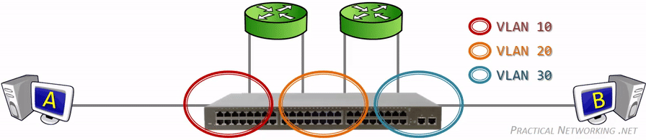
Breaking up one Physical Switch into multiple Virtual Switches

Slide 49
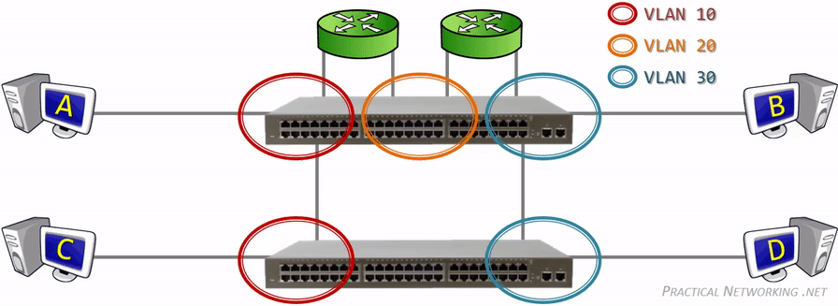
Extending Virtual Switches across multiple Physical Switches

Slide 51
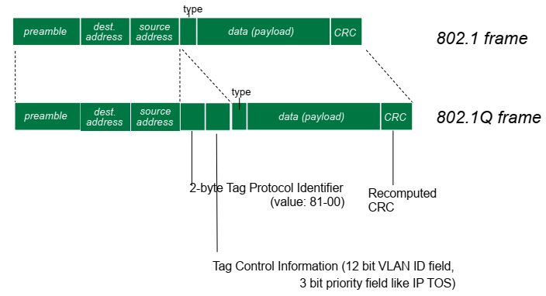
IEEE 802.1Q Frame

Slide 52
